Slide 1
American Sign Language (ASL) Recognition
Presented by: Aya Fathy, Jana Khaled, Mostafa Ashraf, Omar Attia
Dr. Alaa Hamdy
Dr. Noha El-Masry

Slide 2
Problem Statement
Systems that assist people with special needs are in increasing demand these days with the advancement of the technological age. One category of impaired people are deaf and mute people. The sign language was developed to help them communicate but unfortunately not everyone knows the sign language. Developing systems that have sign language recognition can help communication between those groups of people and further enable them and their abilities, save time and energy and make their lives easier and better.

Slide 3
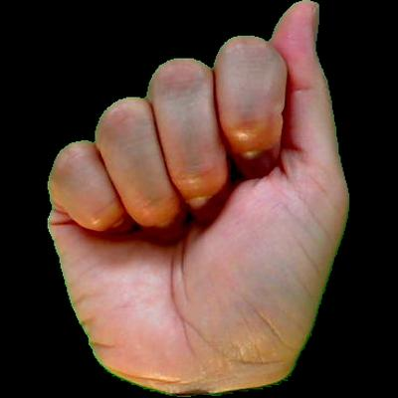
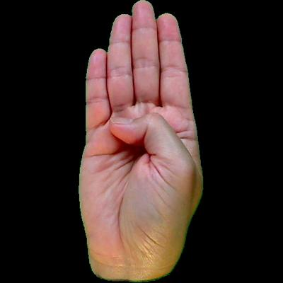
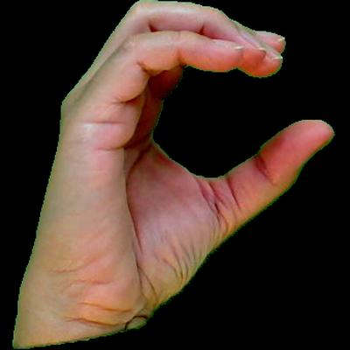
Images and Dataset Description
Letter A
We used an American Sign Language MNIST Dataset that consists of all the alphabet letters except two letters, J and Z. Each letter had 45 images for training and 25 images for testing.
Letter B
Letter C

Slide 4
Block Diagram
Hidden Layer 1
Pre-processing
Input Layer
Output Layer
Output text result
Input Picture
Hidden Layer 2

Slide 5
Algorithms & Techniques
The model relies on Artificial Neural Networks to train the model towards recognizing the different letters.
Libraries used:
Numpy
OneHotEnconder
Keras
SciKit
Pandas

Slide 6
Algorithm & Techniques
The model does minimal preprocessing as the background of all the images are already the same color. There’s an input layer, 2 hidden layers and the output layer. After a trial and error process, we also used the Adam optimization algorithm which we found to give very good accuracy and speed compared to the others.

Slide 7
References
Dataset: https://www.kaggle.com/ayuraj/asl-dataset
Artificial Neural Network: https://missinglink.ai/guides/neural-network-concepts/complete-guide-artificial-neural-networks/
The sequential Model: https://keras.io/guides/sequential_model/
Adam Learning Algorithm: https://towardsdatascience.com/adam-latest-trends-in-deep-learning-optimization-6be9a291375c
Encode Categorical Features: https://www.dataschool.io/encoding-categorical-features-in-python/
OneHotEncoder: https://scikit-learn.org/stable/modules/generated/sklearn.preprocessing.OneHotEncoder.html
Pandas: https://pandas.pydata.org/docs/user_guide/index.html
Basic Keras Neural Network Guide: https://www.kdnuggets.com/2018/06/basic-keras-neural-network-sequential-model.html

